Slide 1

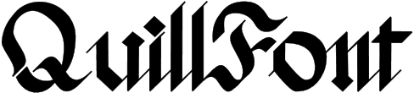
Unleash your creativity, master typography
Notes:
QuillFont is the platform that unlocks typographic creativity, where you can create, explore, practice and collaborate, all in one place.

Slide 2



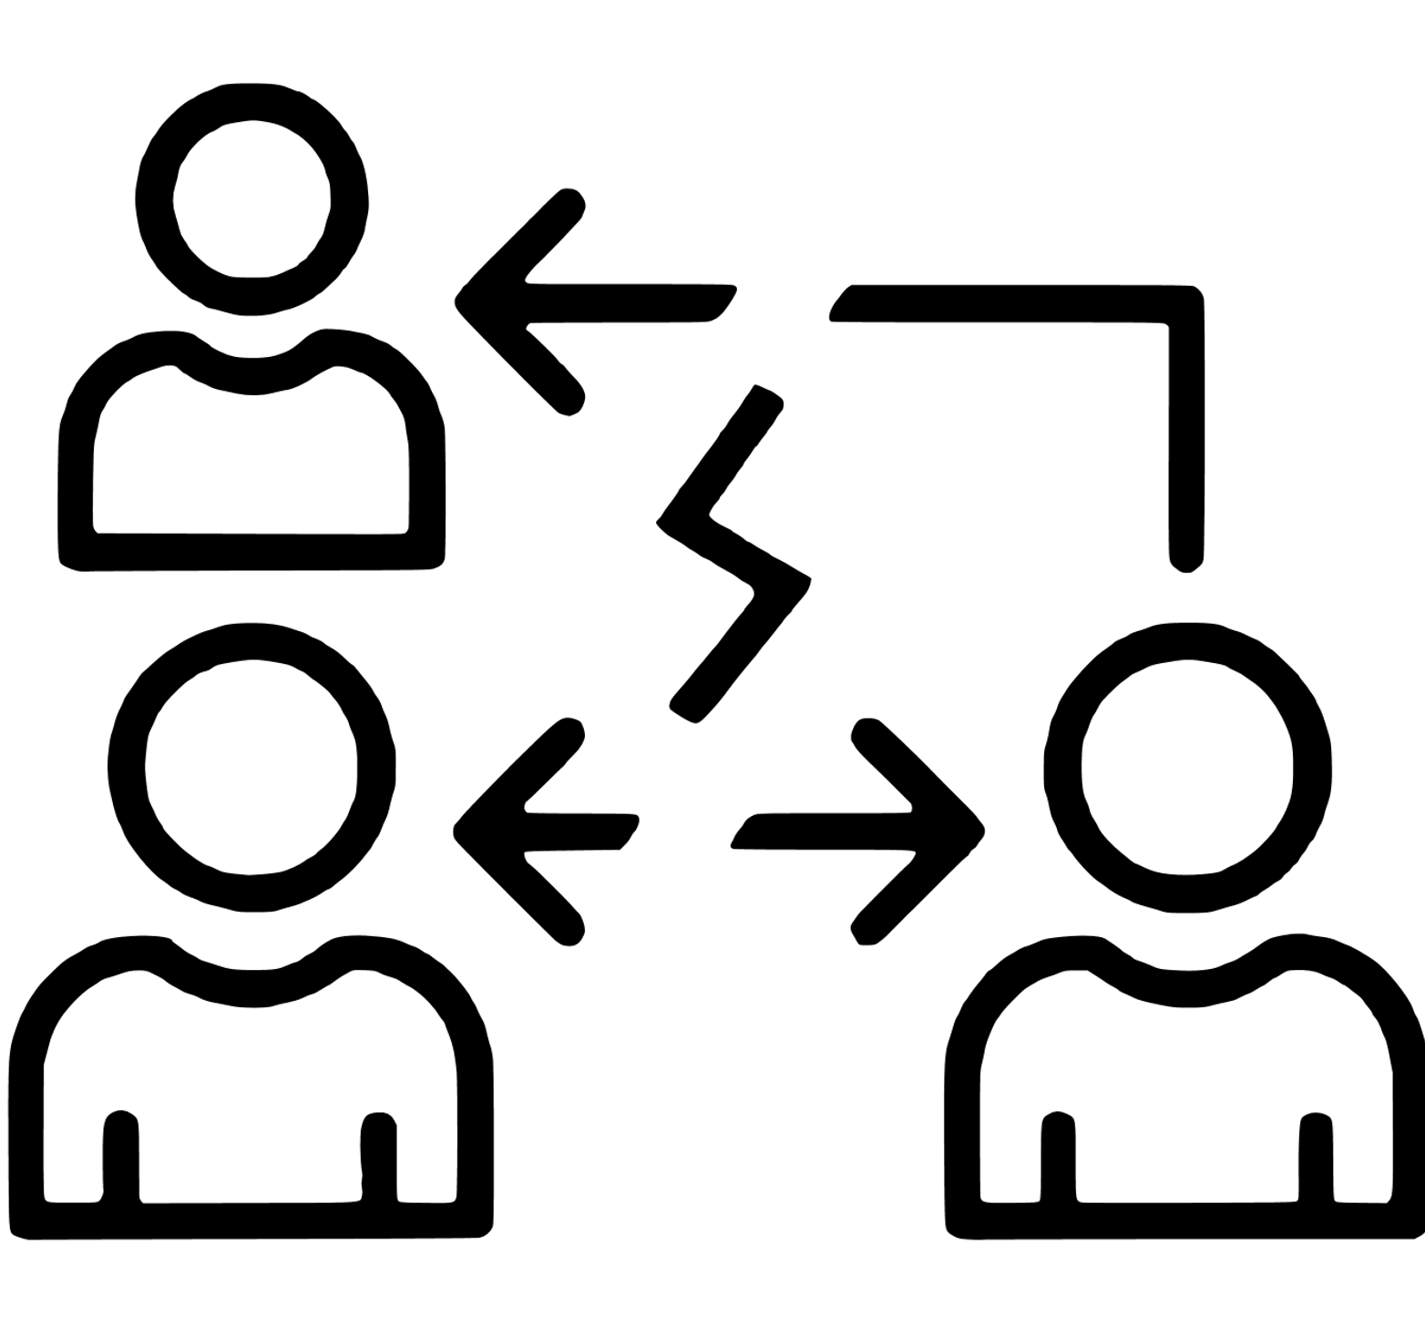
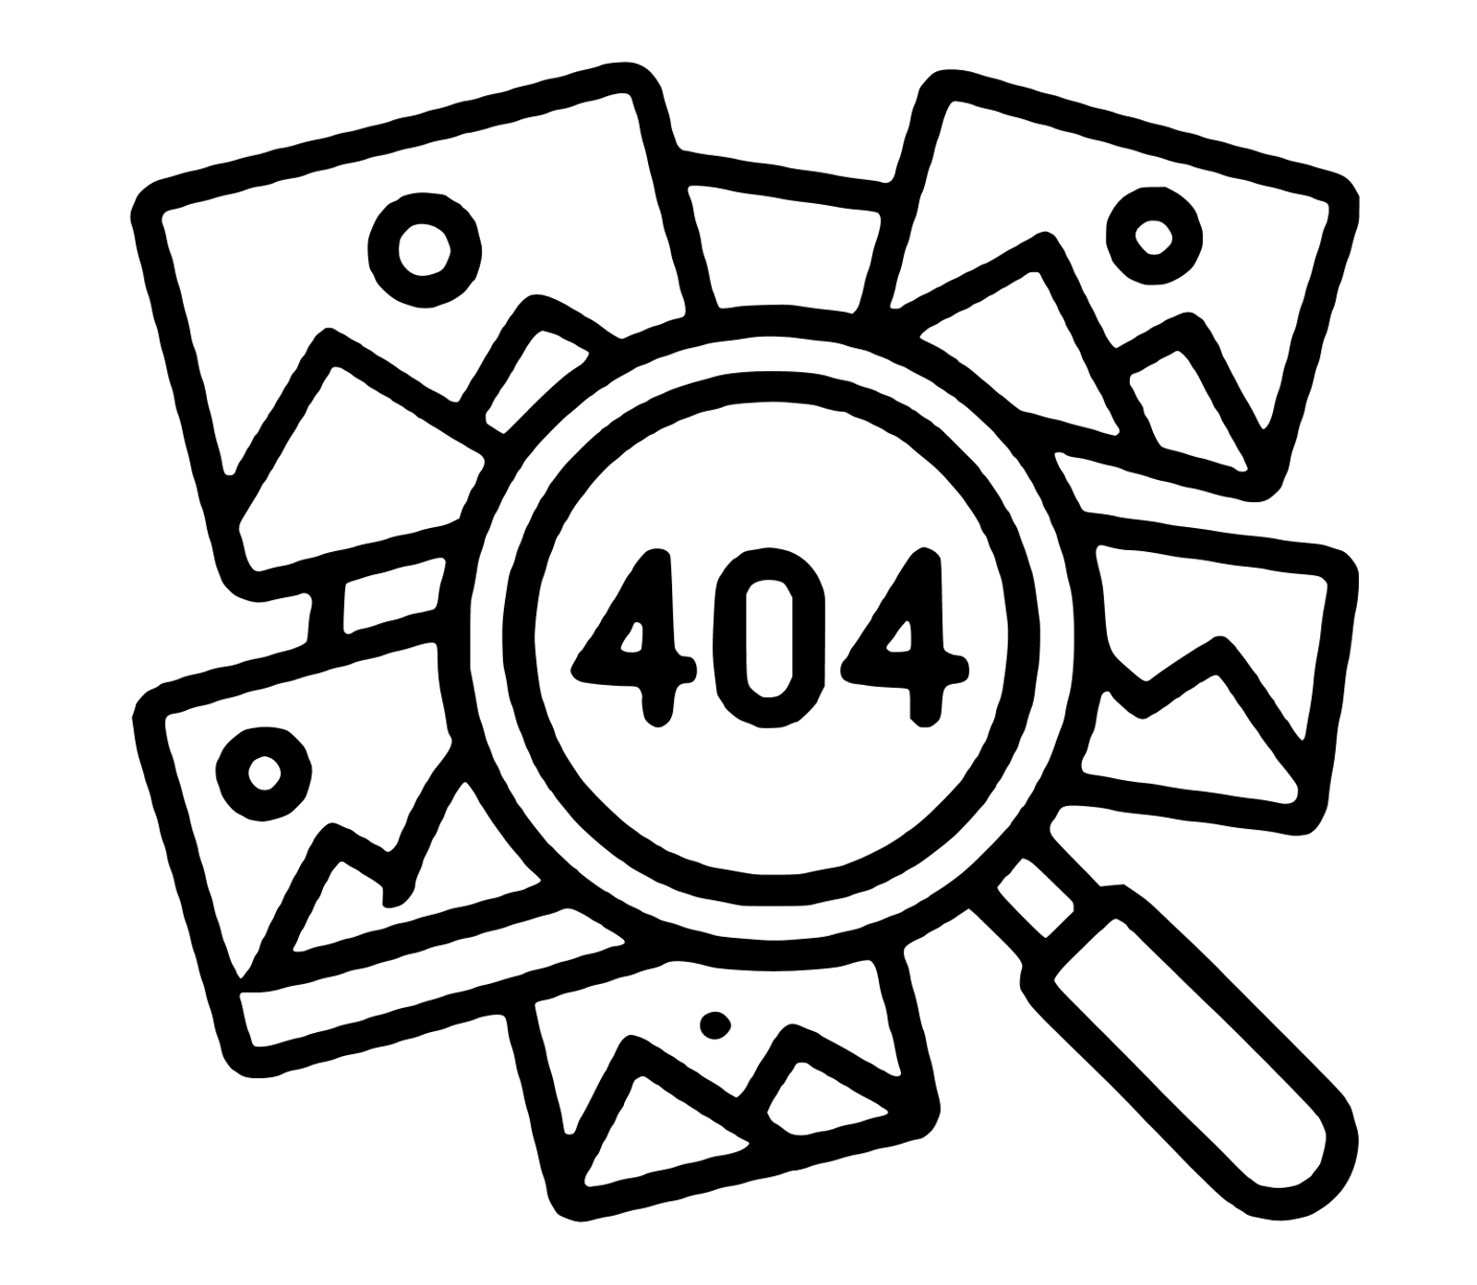
The Current Creative Landscape
Creation
Feedback
Collaboration
Inspiration
Expensive, steep learning curve
Separate tool, lost context
Disconnected workflows
Time-consuming, unreliable
Notes:
Anyone of you who wants to explore the world of typography faces a huge challenge.
The tools available are expensive, complex and very difficult to learn.
And even if you manage to make some progress, the whole process is fragmented: creation happens in one platform, feedback in another and collaboration somewhere else entirely. And to find inspiration? Well, you would have to scroll through endless websites and still risk not finding what you were looking for.

Slide 3
Broken & Inefficient Process
Notes:
All these factors end up generating creative blocks, slowing down projects and making it harder to stay motivated, which can lead to frustration and the users simply giving up.
There are millions of designers and typography enthusiasts who want to explore and grow, but complex and expensive tools end up discouraging them.

Slide 4
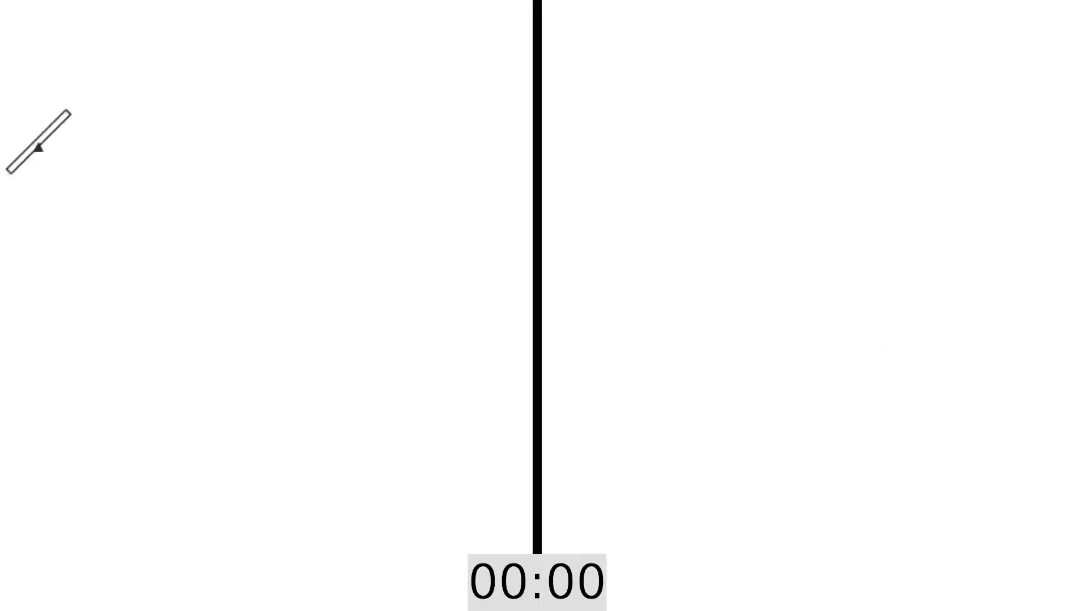
The Solution: QuillFont
Notes:
That's where QuillFont comes in!
We offer a much easier and faster way to create. You are able to draw an entire letter in less than 2 minutes, less time than you would need to draw just the first curve line on another platform.

Slide 5



The Solution: QuillFont
Community & Support
Challenges
Collaboration
Notes:
Overall we present a unified platform that brings together:
- A simple and flexible **editor**
- Creative **challenges**
- An active **community**
- Real-time **collaboration**

Slide 6
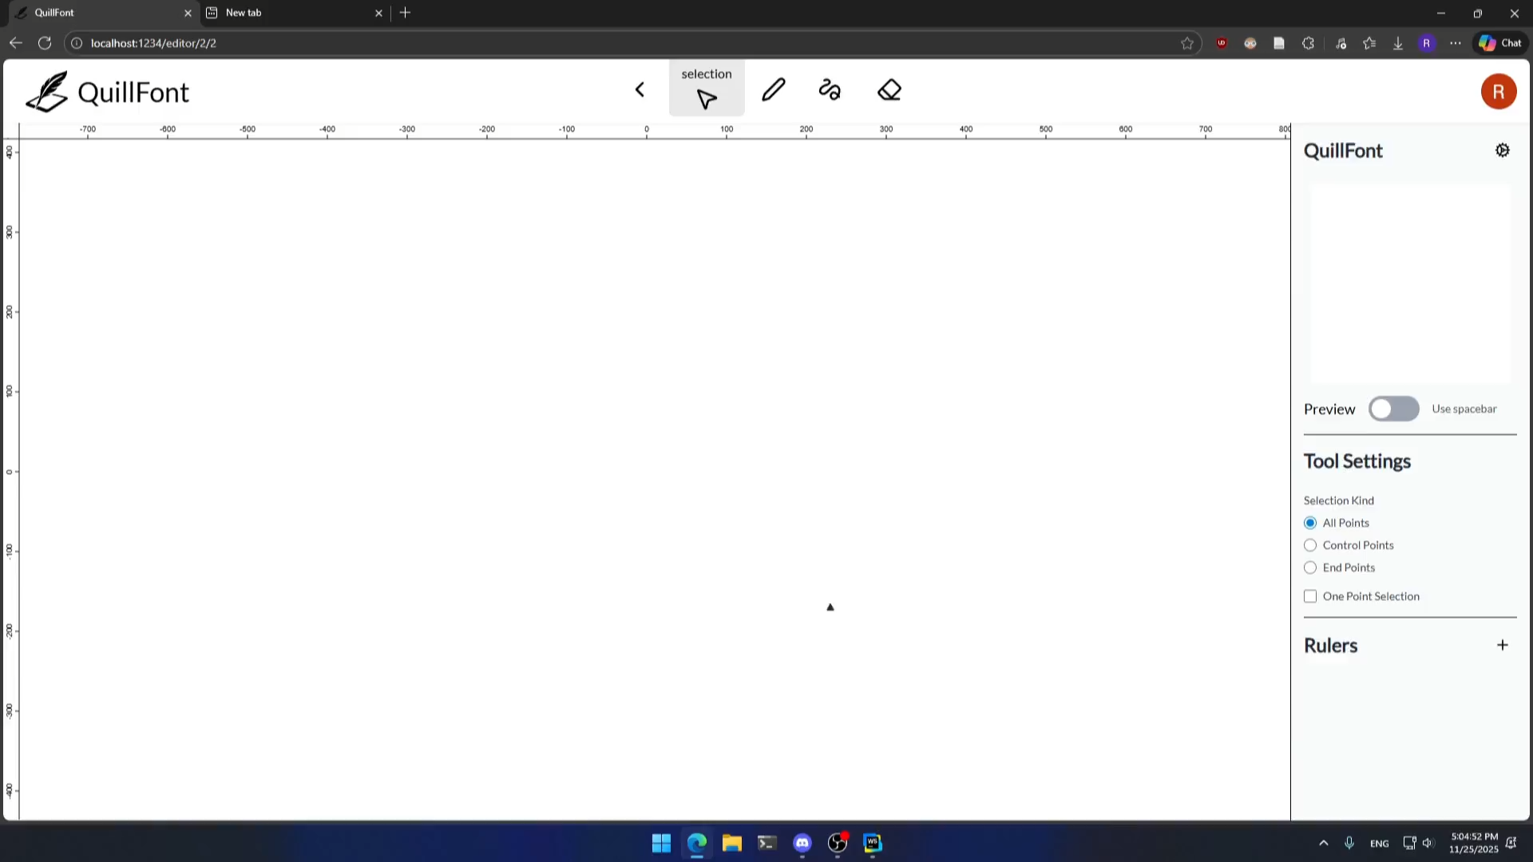
Product — The Editor
Notes:
With our editor you can create from the most simple projects to the more complex ones, making use of
- our clear and intuitive interface with a canvas where your projects come to life
- a tool bar with essential features which can be extended by plugins of new tools and personalized to your own needs
- a side bar to adjust parameters and make every line drawn exactly how you imagined it
- a set of guidelines which can be added to help with sizes and allignments.

Slide 7
The Solution: QuillFont
Community & Support
Challenges
Collaboration
Notes:
Besides that, we will provide regular integrated challenges to increase motivation, boost engagement and help establish regular practice.
We will also focus on maintaining an active community where it's easy to share projects and comment. This way the users will be able to receive feedback, inspiration and recognition for their work.
Finally, our built-in collaboration allows teams to work together with real-time co-editing within the same project
But what really sets us apart is our community-driven approach: we provide an exclusive space dedicated to typography and 100% focused on the creators.
We grow with our community, not just for it, so we become more than a tool. We become a meaningful, thoughtful solution that goes far beyond a simple editor.

Slide 8
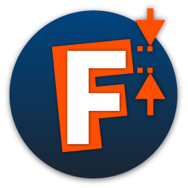
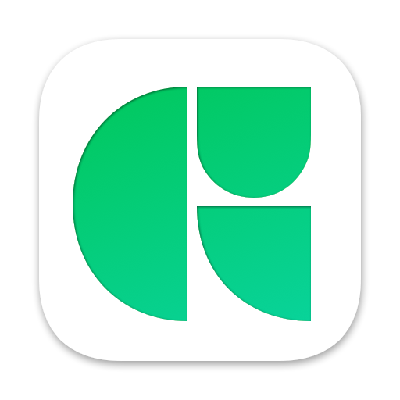
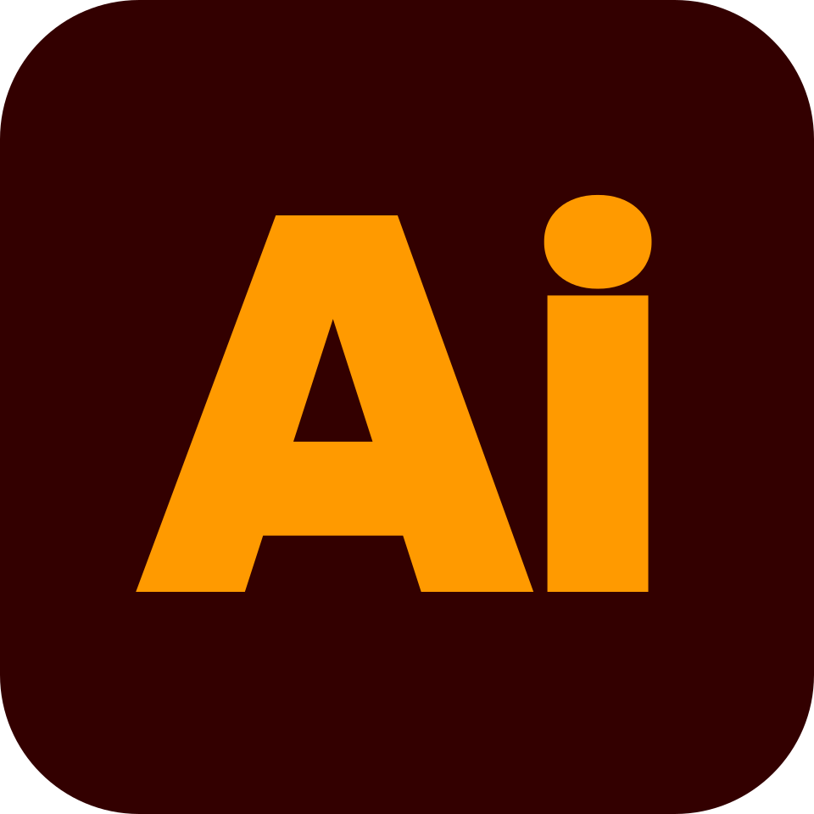



Market Analysis
Advanced
FontLab
Glyphs
Illustrator
RoboFont
General Design
Specialized Type
Procreate
Krita
Basic
Typography Focus
Notes:
Compared with traditional typography tools like Glyphs, Robofont or FontLab which are powerful but highly technical and expensive, QuillFont is approachable, flexible and accessible to all skill levels.
There are also other platforms such as Adobe Illustrator or Procreate, which support creative work but, unlike QuillFont, are not specifically built for typography.
Finally there are also some communities that may provide inspiration and feedback but don't have integrated tools for creation.

Slide 9
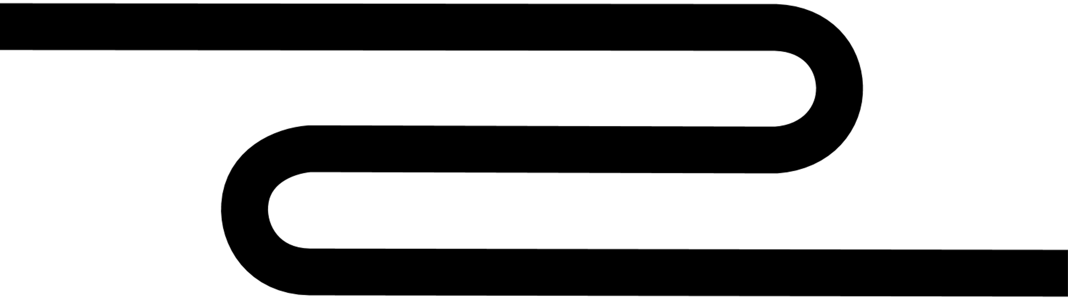

RoapMap
Iteration & Continuous Testing
Refine with every feedback.
Visual Refinement & Stable Version
Polish the look, release the core.
MVP & Market Testing
Build, test, and listen.
2025
2026
2027
2029
2028
Community Consolidation
Connect, share, collaborate.
Licensing Launch
Open access, grow the community.
2030
...
Resource Expansion
Expand features, inspire creativity.
Continuous Growth
Evolve, lead, and solidify.
Notes:
Over the next two years, we’ll release small test versions and a beta to validate usability and resolve issues.
In 2028, we plan to launch our first full public release.
By 2029, we’ll focus on community engagement through challenges and active user participation.
From there, we’ll continue evolving according to users' needs, adding new features such as full font-creation tools, tutorials and mentoring as well as AI support for repetitive tasks.

Slide 10
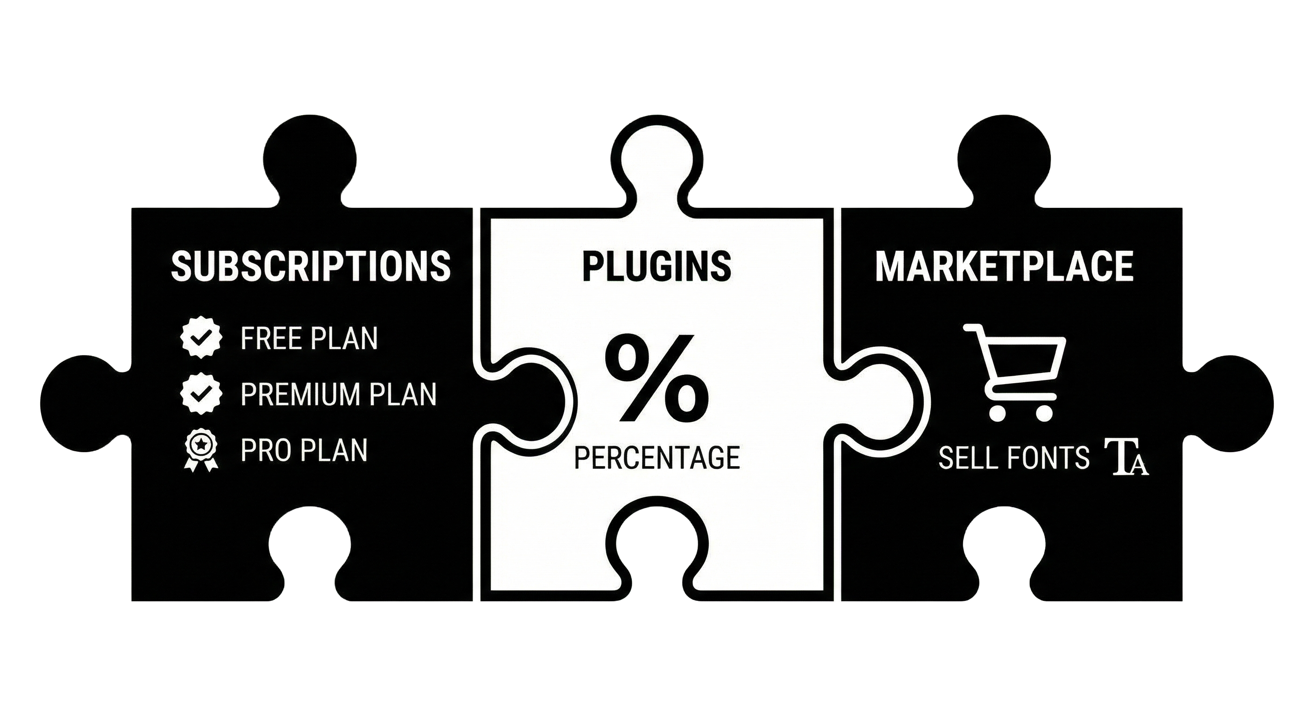
OUR REVENUE MODEL
Notes:
Our revenue will come mainly from subscriptions: Besides the free option, we also have a premium plan with greater project capacity and more advanced tools, and a pro plan with no restrictions. In addition, we will sell our own plugins and apply fees to plugins sold by users.

Slide 11
Unleash your creativity, master typography
Notes:
Our goal is to become the leading global platform for typographic exploration by following the directions and needs of our community, always offering a place where any creator can grow, develop some skills and stay motivated.

